Slide 1
TABE 11/12 Study Guide
For Math Level M
By Marysusan Houk and Jeff McDanald
Jessamine County Adult Education

Slide 2
TABE 11/12 Study Guide for Math Level M
Hello and welcome to the Student Study Guide for the Math Level M TABE 11/12 slide presentation!
This product was created for the Introduction to Assessment for Adult Basic Education (Math for TABE 11/12) online course.

Slide 3
TABE 11/12 Study Guide for Math Level M
This slide presentation explains a little bit about how our Study Guide was created and why it was made.
If you would like to see the Study Guide right now, the link to the PDF is on the last page of this presentation.

Slide 4
TABE 11/12 Study Guide for Math Level M
The Math M was selected because we found that the majority of our students are taking the TABE M Math based on their Locator scores. So our product is fundamentally tied to the TABE M Math -- our most frequently used assessment. It would be safe to say that nearly all of the math concepts and standards from the M Math will be emphasized in our product.

Slide 5
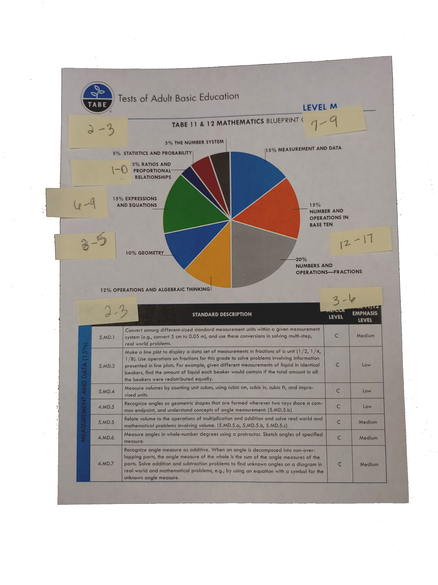
TABE 11/12 Study Guide for Math Level M
When creating the Study Guide, materials from the PLC were used to count how many questions of each type are found on the TABE 11 & 12.

Slide 6
TABE 11/12 Study Guide for Math Level M
This Study Guide Product is focused on the areas of greatest emphasis according to the Blueprints.
So, a primary benefit of the product is having most of the required knowledge accessible in a relatively short 8 page format.

Slide 7
TABE 11/12 Study Guide for Math Level M
Description of Product:
The study guide acts as a one document study aid when reviewing for a progress test.
The study guide acts as a one document study aid when reviewing for a progress test.
It draws instructors’ attention to the changes in content.
It helps drive selection of materials and instruction toward areas of highest emphasis.

Slide 8
TABE 11/12 Study Guide for Math Level M
Thoughts about the product:
Product has been successful in isolating the skills students need to focus on for an M level TABE gain
Students are highly engaged with our product. Student are pleased to have everything they need to review in one document.
Product can be used on a SMART board to facilitate student involvement.

Slide 9
TABE 11/12 Study Guide for Math Level M
More thoughts about the product:
Product is easy for instructors to use. Answers follow each section of problems.
Content is highly relevant to student and instructors needs and extremely time beneficial.
We are just beginning to use the product with students, so we do not have any hard data yet, but except it to be effective in helping students achieve a level gain.

Slide 10

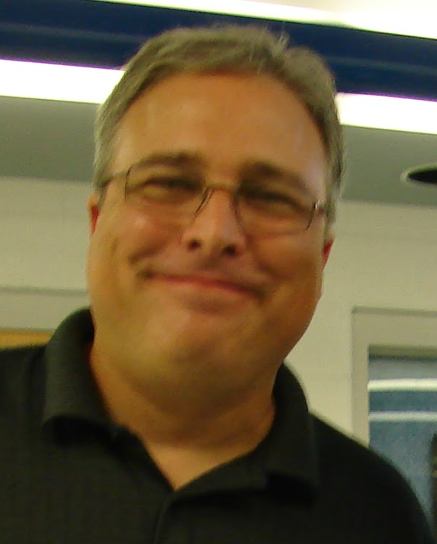
TABE 11/12 Study Guide for Math Level M
This is a team project created by Marysusan Houk and Jeff McDanald. Both are instructors at Jessamine County Adult Education.

Slide 11
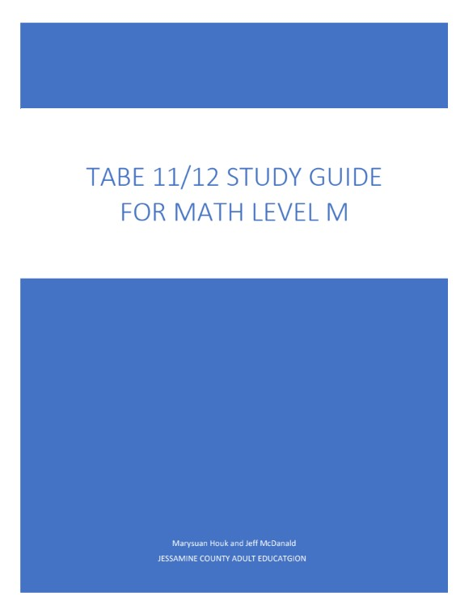
TABE 11/12 Study Guide for Math Level M
Here is the link to the Study Guide we created:
https://drive.google.com/file/d/1cm7sUL8dd3z5WIziNiH2uP1N9r79uMlE/view?usp=sharing

